Slide 1

Highlander Lender Partners
By Aaron Dimaya, Oliver Mendoza, and Nistha Hiteshkumar Chauhan

Slide 2


Our Mission
Platforms like LendingClub have made the P2P market both wide-reaching and easily accessible. However, LendingClub’s infrastructure to identify potentially faulty borrowers is overall inadequate. This leads to lots of unnecessary risk being taken by investors and many potential investors being driven away.
Our firm seeks to remedy this growing problem within the P2P market by introducing the most efficient and effective way to flag risky borrowers: machine learning

Slide 3
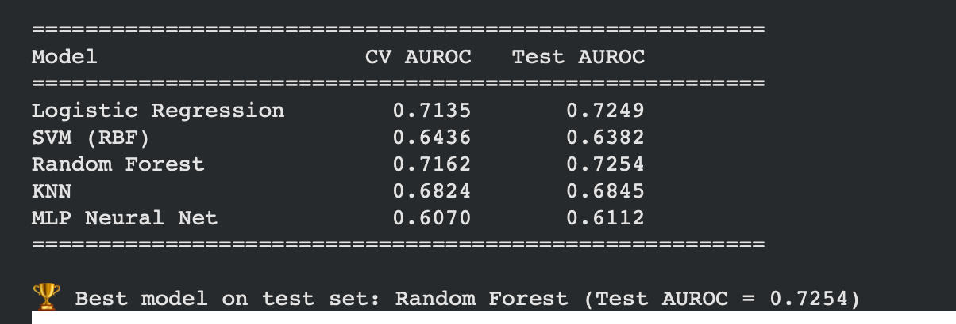
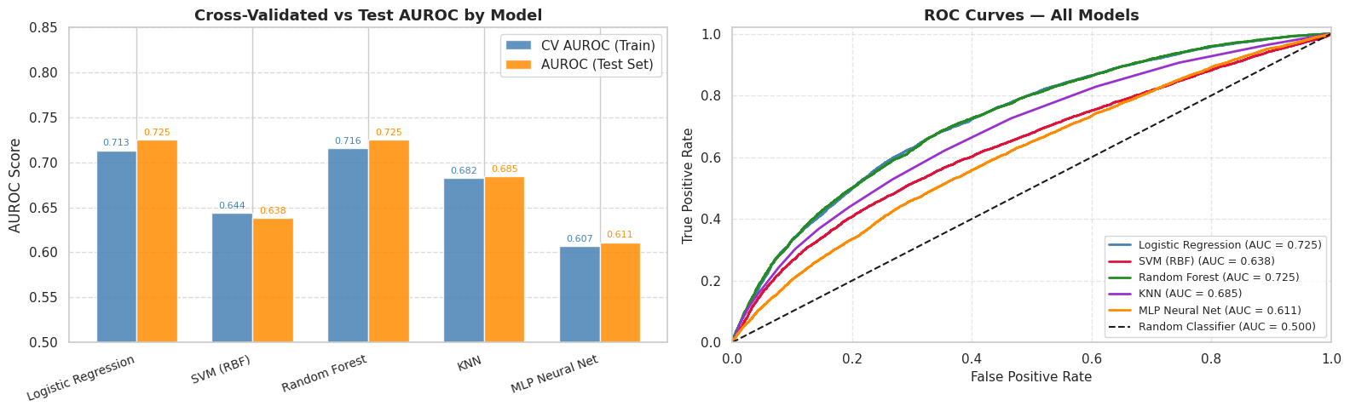
Our Tools

Slide 4
Business Model and Market
Target Customers
Family offices and hedge funds that manage from $10M up to $500M
Registered investment advisors who want even more yield
Investors with capital but no analytical tools
Those who have large capital that can’t ignore P2P, but are too cautious/risk averse due to no tools
Our Edge
Random Forest Model: Test AUROC of 0.7254
Fully automated: no manual underwriting, scales with increased AUM
Continuous retraining as new loan data comes in
Revenue Model
1.5% annual management fee on Assets Under Management
20% performance fee on returns above benchmark
Target: $10M AUM by Year 2, ~$150K baseline fee revenue
Market Opportunity
LendingClub has originated over $90B in loans since founding
P2P lending is a multi-billion dollar alternative asset class
Low institutional participation
Notes:
Open with:
Now we have the Business Model and Market
This is how everything comes together: how we make money, who we’re selling our tool to, and why to choose us
First off, market opportunity
LendingClub alone has gotten over 90 bil in originations. The market is huge and its not slowing down
However, most institutional investors arent in it, not because they don’t want extra money, but because they don’t have a tool like ours
This is where we come in
So here’s our revenue model, its very straightforward; 1.5% management fee on everything we manage, an extra 20% cut on returns that are above our benchmark. This is standard for institutional funds and it keeps our incentives aligned with our investors.
Basically, we only win big when they win big. At 10 million assets under management by the second year, that should give us 150k in baseline revenue before any performance fees.
Next, where we shine, our edge.
This is where we’re different; our random forest model has a test AUROC of 0.7254, slightly above industry baseline of 0.72. This gives us confidence in our result to perform, and at the same time, our system is fully automated and always retraining on new data. No manual underwriting, no human bottleneck. As it grows, it will scale guaranteed.
And lastly, who we’re selling to:
We want institutional investors that are in the 10 to 500 M range; family offices, hedge funds, advisors; they are sitting on funds and want to make more money with them but with no data or tools, they can’t. We’re both the vehicle and infrastructure for them.
And so we move onto our next slide, our asks.

Slide 5

What are we asking?
What are we asking?
The Money
How it Will Be Used
The Timeline
$2 Million in Seed Funding
Equity based investment in Highlander Lending Partners
$1.2M: Deployed investment capital on LendingClub
$400K: Engineering/Infrastructure
$250K: Operations/Compliance
$150K: Marketing/Investor Relations
Year 1: LendingClub live environment, model validation
Year 2: $10M Assets Under Management, expand to new platforms
Year 3: $50M Assets Under Management, expand as a standalone service
We have the model, we know the market. We need the capital!
Notes:
We are asking for 2 million in seed funding to get highlander lending partners off the ground
The majority will be used into deployed capital on LendingClub, 1.2 million. That is giving us funds to make money immediately, generating real returns from the jump. The rest will go towards other things like engineering/infrastructure, operations and compliance, and marketing/investor relations
Now, our timeline and milestones
The first year is about the proof; we’ll run it in a live environment, build a track record, and show that our model will hold up in the real world
The second year would be to expand beyond lendingclub into new platforms, giving us even more capital.
By the third year, we should have around 50 mil in assets under management, and potentially open up as a standalone service rather than just partners
With that, we’ve shown you that we have the tool from our model, we know the market and the business, we just need the money to execute.

